Slide 1
Bubba Gump Shrimp Company Survey Analysis

Slide 2
Objectives
Increase restaurant sales
Increase third-party retailer sales

Slide 3
Data Sources
Bubba Gump Shrimp Company customer surveys
500 random customers who have purchased an item at one of our restaurants
Population Data (United States Census Bureau, n.d.)
2019 estimates of population by zip code broken down by 5 year age ranges
Income Data (United States Census Bureau, n.d.)
2019 estimates of income by zip code broken down by $10K or $25K ranges and category (Households, Families, Married-couple and Nonfamily)

Slide 4
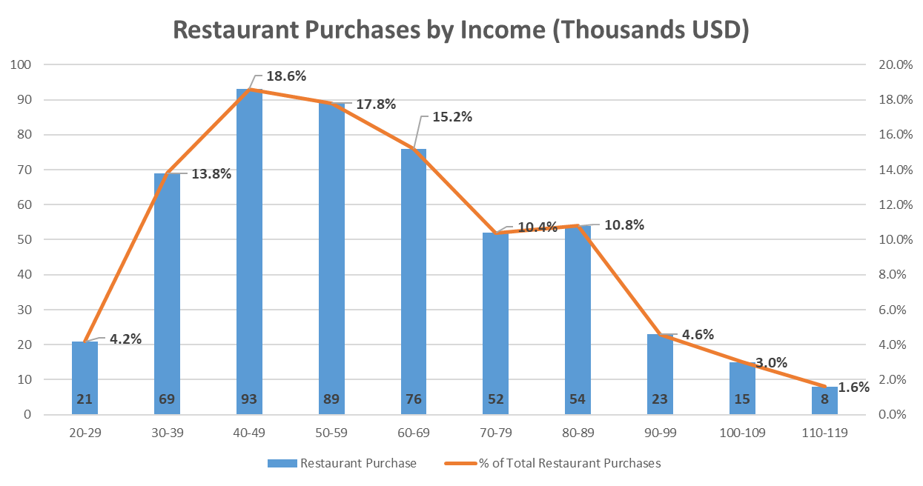
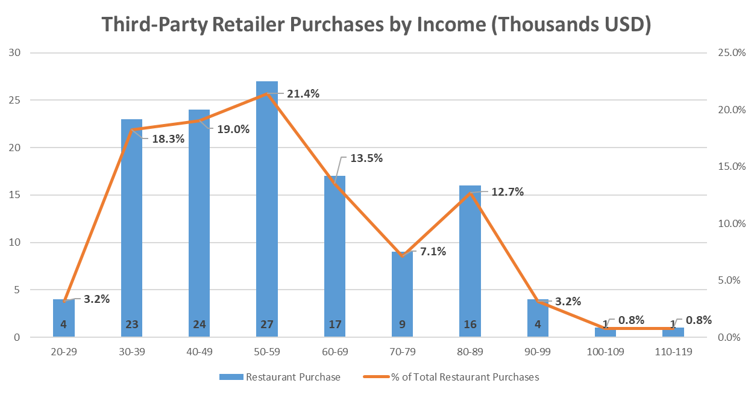
Purchases by Income
Incomes of $40K-$59K make up most of our restaurant and third-party retailer purchases
$40K-$40K make up 37.6% of combined purchases
$50K-$59K make up 39.2% of combined purchases

Slide 5
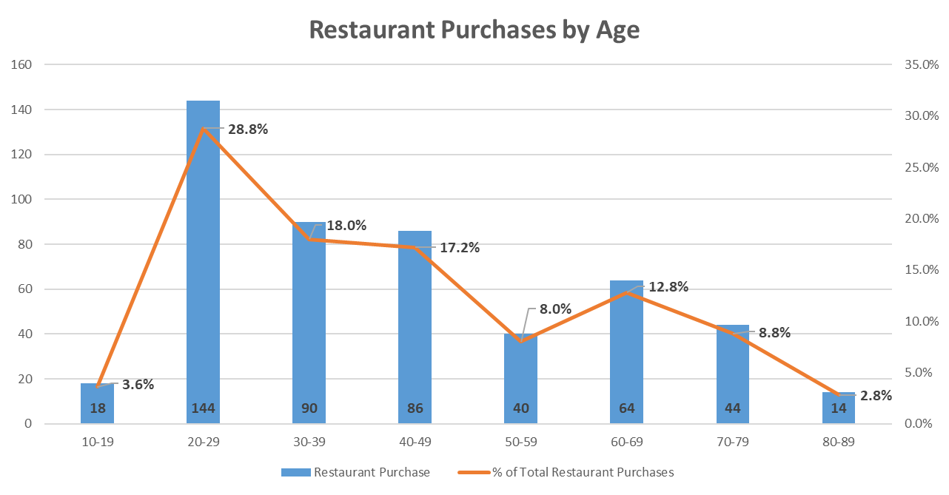
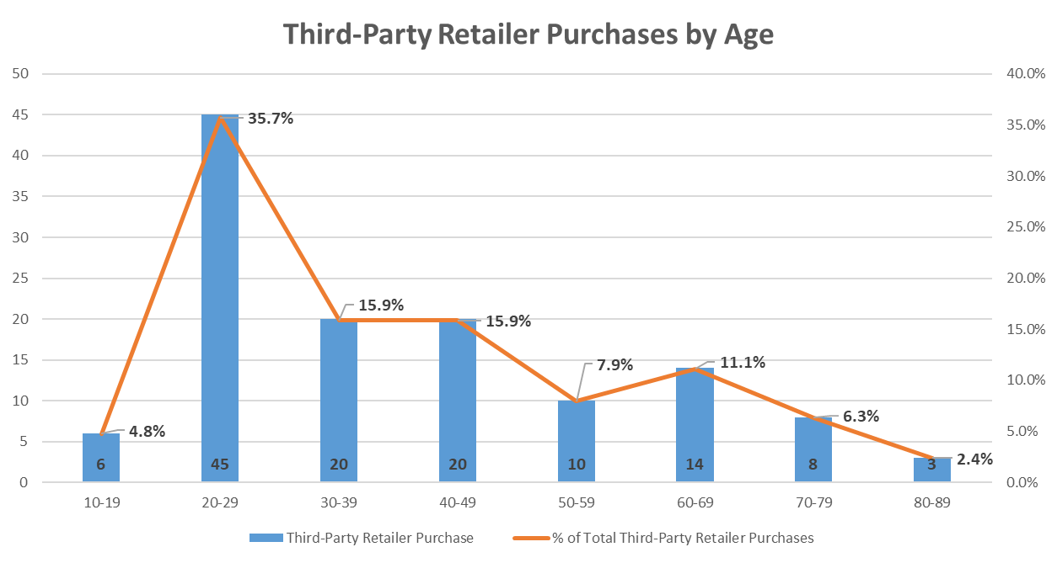
Purchases by Age
Ages 20-29 make up the most of our restaurant and third-party retailer purchases

Slide 6
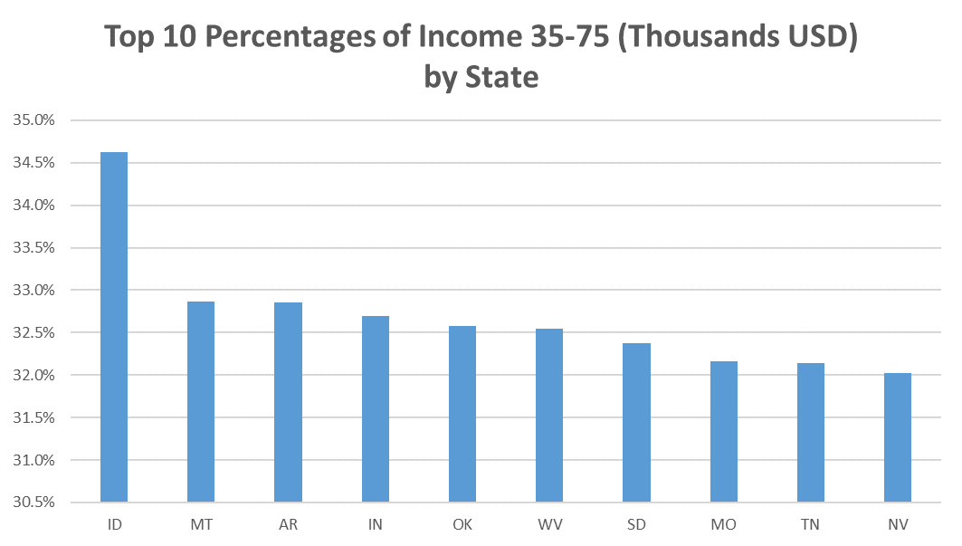
Top 10 States with the highest percentage income of $35K-$75K
Top 10 states to focus on for income are…
Idaho, Montana, Arkansas, Indiana, Oklahoma, West Virginia, South Dakota, Missouri, Tennessee and Nevada

Slide 7
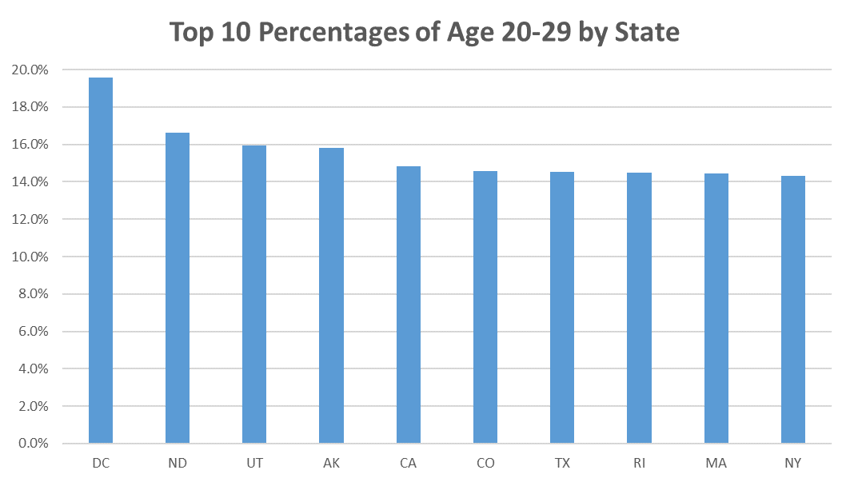
Top 10 States with the highest percentage ages 20-29
Top 10 states to focus on for age are…
District of Columbia, North Dakota, Utah, Alaska, California, Colorado, Texas, Rhode Island, Massachusetts and New York

Slide 8
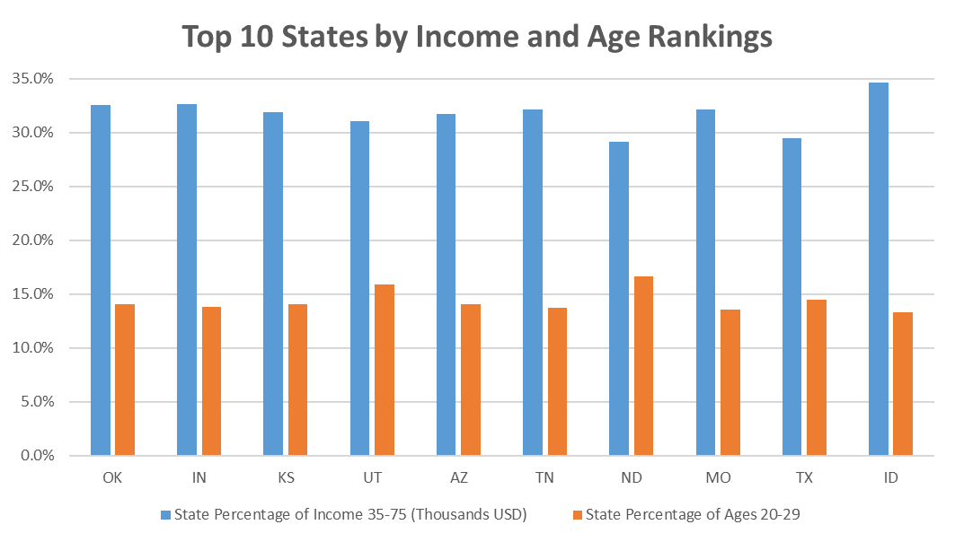
Top 10 States by Income and Age Rankings
Top 10 states to focus on for income and age rankings are…
Oklahoma, Indiana, Kansas, Utah, Arizona, Tennessee, North Dakota, Missouri, Texas and Idaho

Slide 9
Recommendations
Increase presence and awareness of affordability in Idaho, Montana, Arkansas, West Virginia, South Dakota and Nevada
Increase presence and appeal to a younger crowd in District of Columbia, Alaska, California, Colorado, Rhode Island, Massachusetts and New York
Increase presence, awareness of affordability and appeal to a younger crowd in Oklahoma, Indiana, Kansas, Utah, Arizona, Tennessee, North Dakota, Missouri, Texas and Idaho

Slide 10
References
United States Census Bureau. (n.d.). AGE AND SEX. Retrieved August 1, 2021, from https://data.census.gov/cedsci/table?t=Age and Sex&g=0100000US.860000&y=2019&tid=ACSST5Y2019.S0101
United States Census Bureau. (n.d.). INCOME IN THE PAST 12 MONTHS (IN 2019 INFLATION-ADJUSTED DOLLARS). Retrieved August 1, 2021, from https://data.census.gov/cedsci/table?t=Income and Poverty&g=0100000US.860000&y=2019&tid=ACSST5Y2019.S1901

